Slide 1
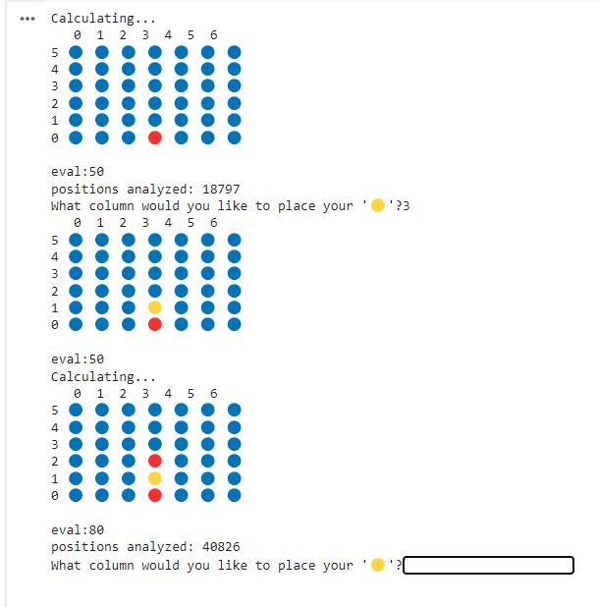
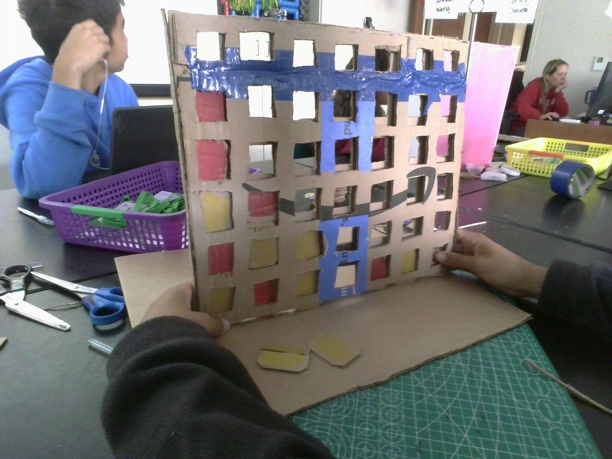
Connect 4 Functional Cardboard Model and AI
Title
Names
Related Graphic
By William Allen, Joshua Wang, and Ethan David

Slide 2
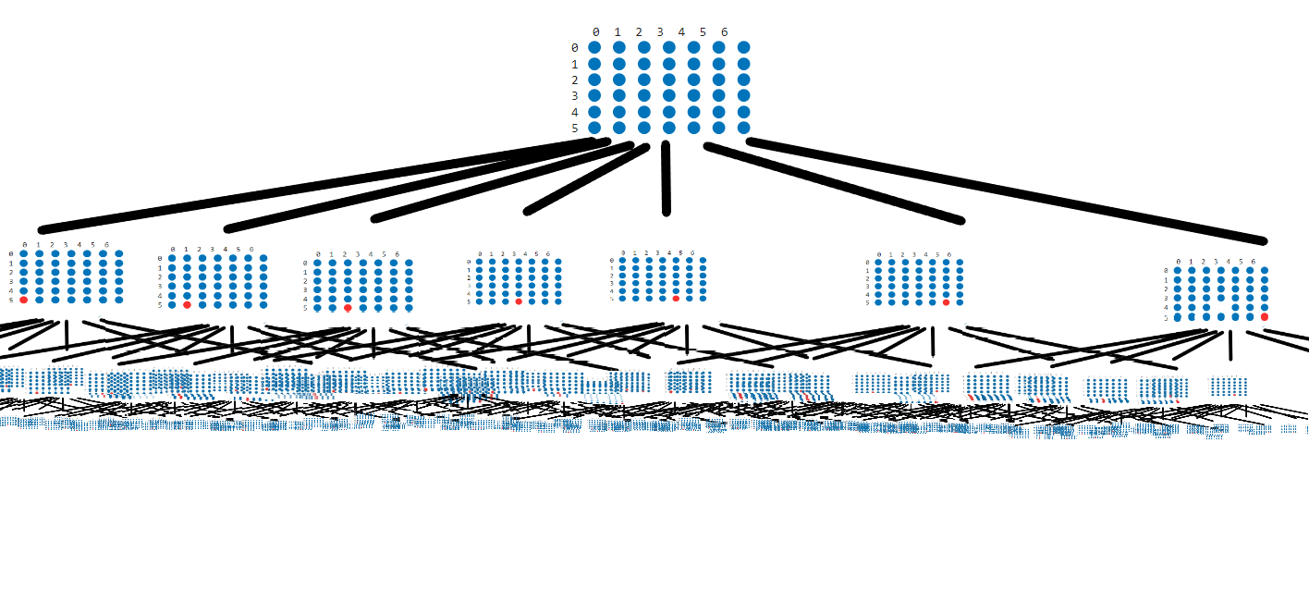
Connect 4 AI - Minimax
The minimax algorithm generates all possible moves for each turn, then does it again for each of the moves it just made, and again, and again
Calculating every single possible board position would be improbable since there are 4,531,985,219,092 legal board configurations
Start
Turn 1
Turn 2
details of project
information needed
at least 1 informative video
at least 2 graphics
Turn 3
⬆️Wow that’s a lot!⬆️

Slide 3
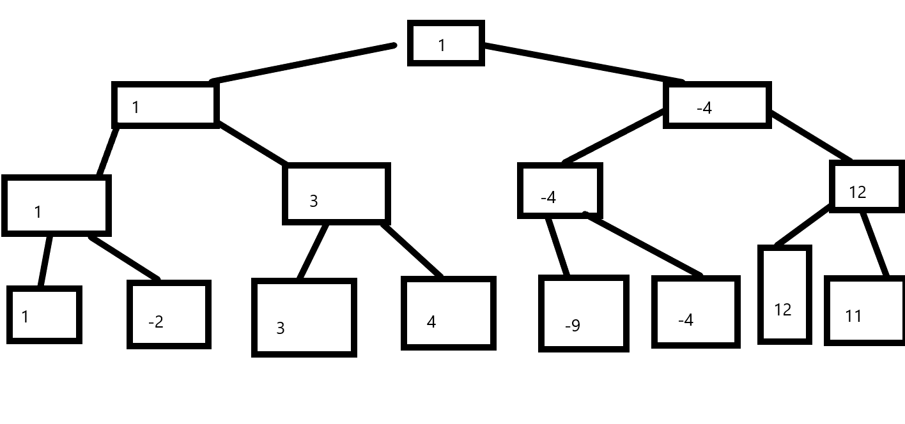
Connect 4 AI - Minimax part 2
A basic minimax algorithm will score each board with the largest depth. The AI will try to maximize the score, while its opponent will try to minimize it. Each parent of each board will gain either the lowest or highest score of its possible moves depending on who’s move it is. After all of the boards have a score, the AI will choose the best move it can with the knowledge available. The scores of the boards on the bottom are often decided by a separate evaluation function.
Maximize (AI’s turn)
Minimize (Player’s turn)
Maximize (AI’s turn)
Minimize (Player’s turn)

Slide 4
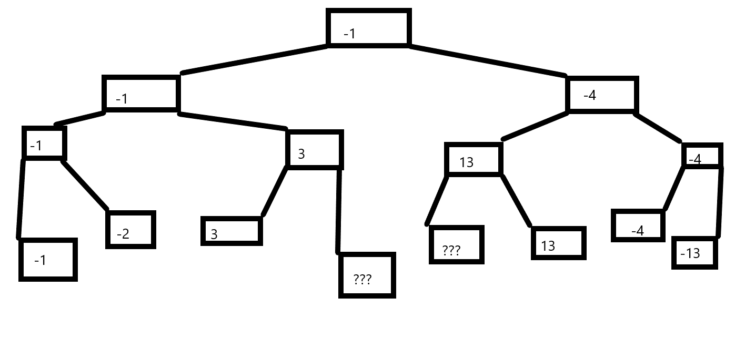
Alpha-Beta Pruning
Alpha-Beta Pruning can drastically improve the efficiency and runtime of the minimax algorithm. Essentially, what alpha-beta pruning does is it does not calculate unnecessary positions for the AI that it would never make. For example, in the figure below, the AI does not have to calculate the boards with questions marks, since on the one on the left, the 3 calculated is already more than the -1 on the other side, so there is no use calculating the other board because the AI wouldn’t choose to go that path anyway since it is trying to minimize the score. The reason why the board on the right is able to be skipped is left as an exercise to the reader. This simple graph may make it look like alpha-beta pruning is just a small optimization, but with more complex graphs such as the ones in chess and connect 4, it is an extremely valuable tool in improving the runtime of the program while yielding the same outputs that the basic minimax algorithm provides.

Slide 5
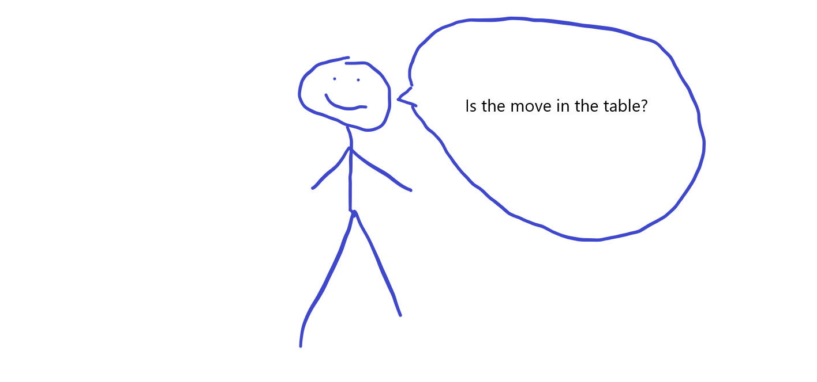
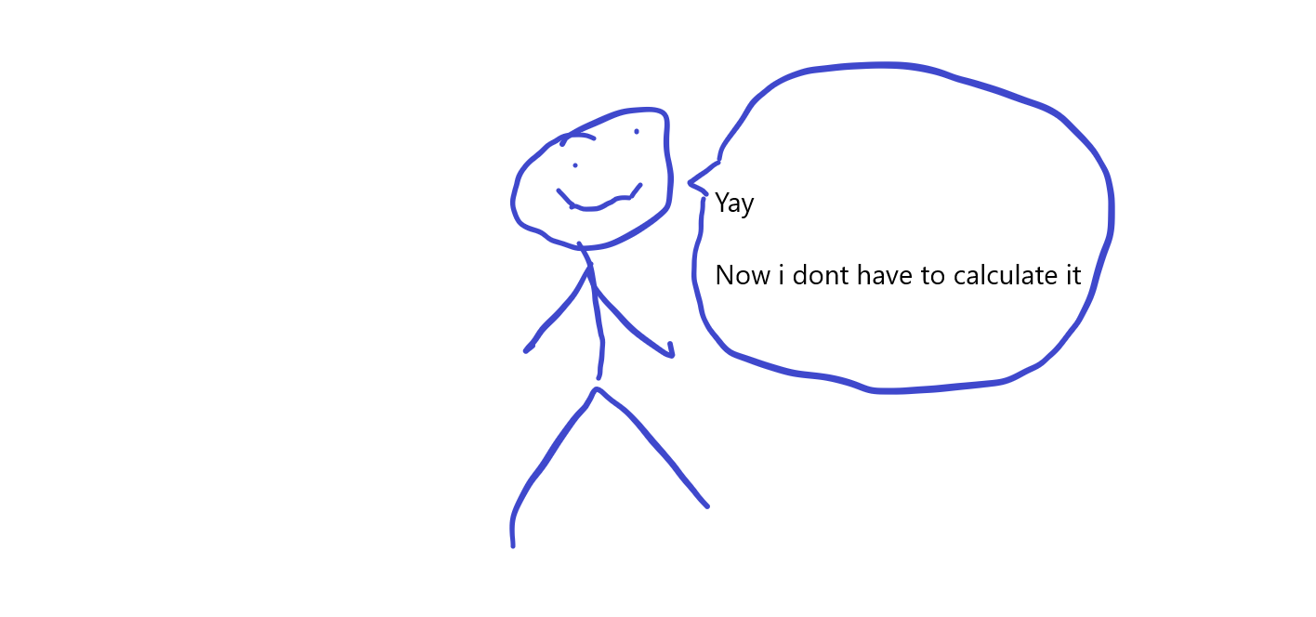
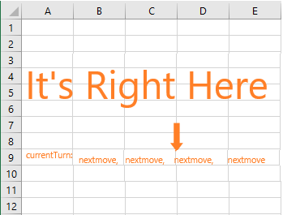
Transposition Table
Basically what a transposition table does is it eliminates the possibility of the minimax algorithm calculating some board states more than once. This can happen because there are multiple ways to get to each position. To make sure that boards are not evaluated more than once, the a all boards calculated by the minimax algorithm can be put into a table, and then during the minimax algorithm, before performing calculations on a certain board state, it checks if it is in the transposition table already to avoid unnecessary calculations.

Slide 6

Minimax Logic Video Summary

Slide 7
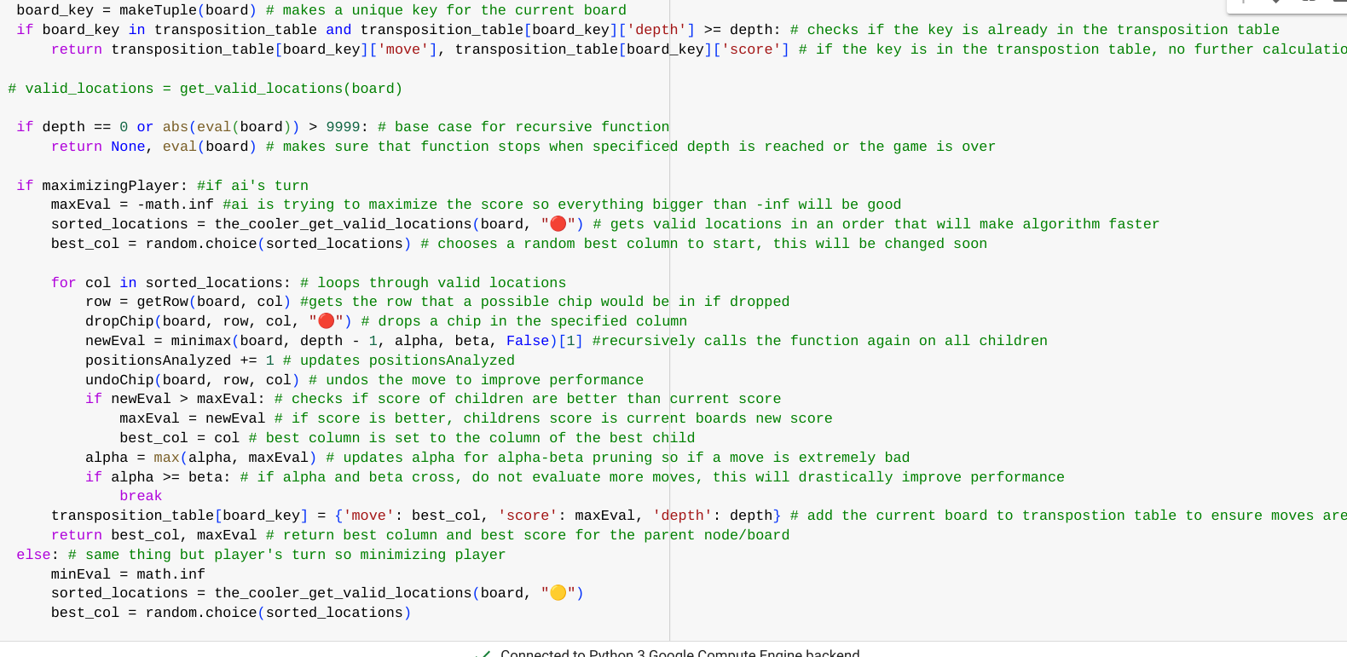
Implementation of AI
Click Here to see the AI's code with comment explanations
See if you can beat the AI!
directions on how to create the project
at least 1 video or graphic

Slide 8
Sample Project Slide
one that you create
Include a video or picture HERE
Physical model will be submitted as well
Click Here to Play Hydrus AI v2.0

Slide 9

Rubric Slide
requirements to earn full credit
You can link a document HERE or use the slide

